Slide 1
Enron Presentation

Slide 2
About Enron
A Global Energy and Communications Company with:
$40 Billion in 1999 Revenues (#18 on Fortune 500)
20,000 employees worldwide
Over 50 offices in 30 countries

Slide 3
It’s Different Here
We constantly ask “Why?”
We invent ways to do the impossible
We exemplify a New Economy company, offering innovation of a dot-com, stability of FORTUNE 500, and trading expertise of Wall Street

Slide 4
Rules for a New Economy—Company
Derives strength from knowledge, not just physical assets
Operates globally, effortlessly
Sees constant innovation as only way to outperform competition
Uses information adeptly to restructure organizations and boost productivity

Slide 5
Enron’s Business Model
Identify and manage risk opportunities
Redefine products and services as commodities
Create liquid markets by developing unique networks
Develop a trading forum for product and services at www.enrononline.com

Slide 6
The Business Case—Gas
The Problem
Deregulation of the gas industry resulted in fluctuations in price of gas
Enron’s Solution
Began selling gas price options and hedges to lend stability to industry
Developed EnronOnline to allow users to transact instantaneously with real-time prices for a range of energy and related commodities

Slide 7
The Business Case—Weather
The Problem
Companies lose money when extreme weather conditions drastically affect supply and demand
Enron’s Solution
Enron began selling options on the weather, allowing companies to hedge the financial effects of extreme weather conditions
Companies can now swap and trade options on www.enronweather.com

Slide 8
The Business Case—Bandwidth
The Problem
Inflexibility of bandwidth contracts resulted in companies paying for unused bandwidth
Enron’s Solution
Began partnership with Sun Microsystems to trade surplus bandwidth using Sun routers
Became unique one-stop source for all broadband services
Premium broadband market expected to grow 150% annually, 2000-2004

Slide 9
The Businesses—Enron Energy Services
Uses our procurement, forecasting and modeling capabilities to manage energy needs of big businesses

Slide 10
The Businesses—Enron Energy Services
The Results
Signed retail business contracts totaling $8.5 billion in value, more than double the 1998 totals
Widened competitive advantage

Slide 11
The Businesses—Enron North America
Modernizes the once heavily regulated energy market by creating a wholesale market with on-demand generation and creative financing instruments.

Slide 12
The Businesses—Enron North America
The Results
#1 trader and marketer of gas and power in North America
Traded first weather-indexed transaction in August 1997 and completed transactions in 1999 with a notional value of $700mm
Significant financial trading team focused on interest rate, F/X and equity positions across Enron
Incubator for new businesses (EES, EBS and Enron Net Works)

Slide 13
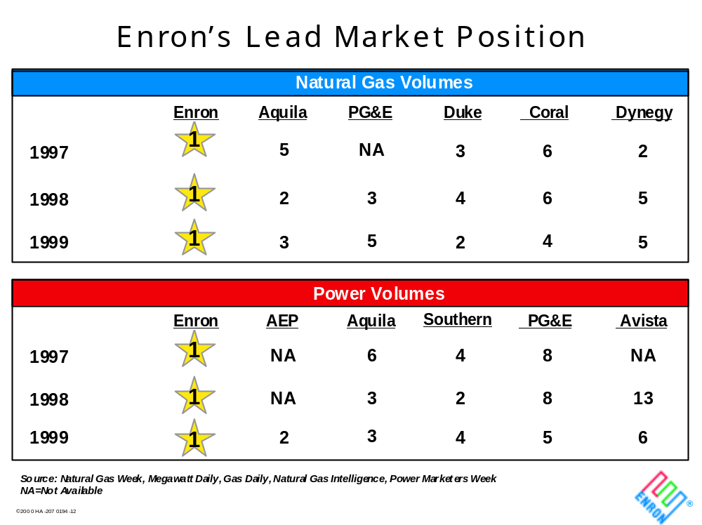
The Businesses—Enron North America

Slide 14
The Businesses—Enron Net Works
Offers global, 24-hour online trading of products at www.enrononline.com
Enjoys advantage of being first to enter field
Built site in-house in seven months
Stands as the only global principal-based system to view real-time prices and transact instantaneously
  multi-commodity
  multi-currency
  multi-lingual

Slide 15
The Businesses—Enron Net Works
The Results
Carried more than $50 billion in notional value in its first half year
Daily notional value of approximately $1 billion

Slide 16
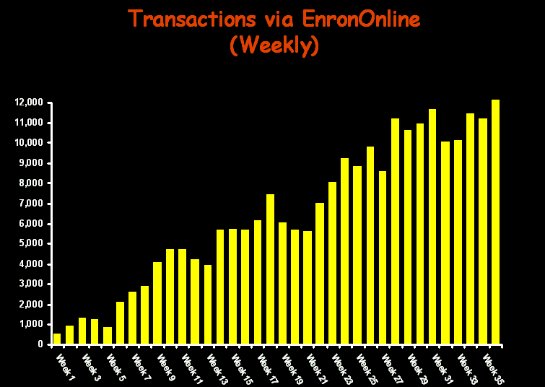
The Businesses—Enron Net Works
Transactions via EnronOnline
(Weekly)

Slide 17
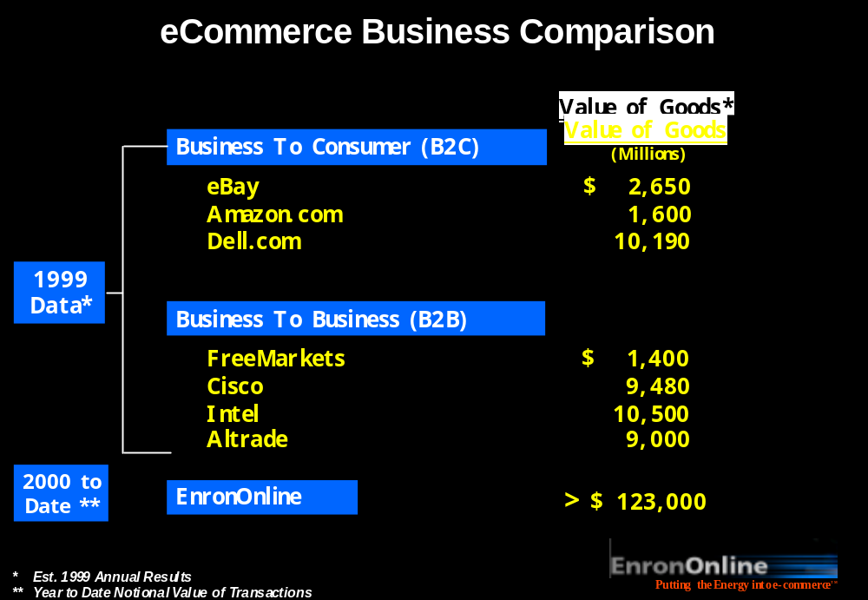
The Businesses—Enron Net Works

Slide 18
The Businesses—Broadband Services
Invented a market to trade bandwidth as a commodity, and also sell it directly to customers

Slide 19
The Businesses—Broadband Services
The Results
Established benchmark bandwidth contracts
Uniquely positioned in a market with 150% growth potential for each of the next 4 years

Slide 20
The Common Thread
Creative
Proactive
Risk-taking
Flexible

Slide 21

What People Are Saying About Us
“In less than a decade . . . Enron has emerged from its unlikely perch in the utility industry as a model for the new American workplace - every bit as much as the Silicon Valley start-ups that usually come to mind when the subject is entrepreneurship or innovation.”
SUNDAY, JUNE 27, 1999

Slide 22
Accolades
“Most Innovative Company” 2000
“Most Innovative Company” 1999
“Most Innovative Company” 1998
“Most Innovative Company” 1997
“Most Innovative Company” 1996
“100 Best companies to work for” 2000
“100 Best companies to work for” 1999
— Fortune
— Fortune

Slide 23
What We Value
Respect
Integrity
Communication
Excellence

Slide 24
What It’s Like to Work Here
Work environment
  fast-paced
  sometimes chaotic
  intense
  unstructured
  flexible
Houston
  #1 US city for entrepreneurship & growth
  4th largest city in America
  low cost of living

Slide 25
The Analyst Program
A program designed to develop skills in, finance, accounting, modeling, data analysis and trading.
Undergraduate degree
2 year program; 1 year rotations
Stepping stone to top-tier MBA programs
Opportunities to receive financial support for business school

Slide 26
The Analyst Program
We also offer two specialized analyst tracks
Tax Analysts focus on tax auditing and accounting
Technologists work on projects such as software development, internet applications, networked systems, infrastructure design
Graduate or undergraduate degree
2 year program; 1 year rotations
Opportunities to receive financial support for professional certifications

Slide 27
The Associate Program
Graduate degree
18-24 month program
3-4 six month rotations
  Designed to develop skills in originating, structuring, execution, trading and finance
Immediate exposure and impact
Eligible for promotion to manager after 18 months

Slide 28
Goals of the Program
Understand the business
Build relationships
Experience our culture
Add value

Slide 29
What’s Next—Recruiting Process
Round 1 Interviews
Two thirty minute back-to-back interviews conducted on-campus with management representatives
Round 2 Interviews
Occur the next day with two thirty minute back-to-back interviews typically conducted off-campus with senior management representatives

Slide 30
What’s Next—Recruiting Process
Super Saturday
Interviews conducted in the Enron Houston Office with senior management representatives
Planned weekend activities that allow candidates to meet additional Enron employees and explore the Houston area
Offers
Results of interviews verbally communicated to all candidates on the Monday following Super Saturday

Slide 31
Dates on Campus
Career Fair - September 20
Resume Drop Deadline - September 19
Campus Interviews - October 9 and 10

Slide 32

Enron
It’s Different Here.

